Slide 1

Market Basket Analysis
Sai Komaravolu

Slide 2
Agenda
Problem statement
Data inferences
Data analysis
Market Basket Analysis
Associations
Offer sugesstions

Slide 3
Problem statement
A Grocery Store shared the transactional data with you. Your job is to identify the most popular combos that can be suggested to the Grocery Store chain after a thorough analysis of the most commonly occurring sets of items in the customer orders. The Store doesn’t have any combo offers. Can you suggest the best combos & offers?.

Slide 4
Data inferences
Data set has 20641 entries in it, with 3 columns “Date”, “Order_id” and “Product”.
Date is of Object type, Order_id is of Integer type and Product is of Object type.
There are no Null or Invalid records found in the data set.

Slide 5
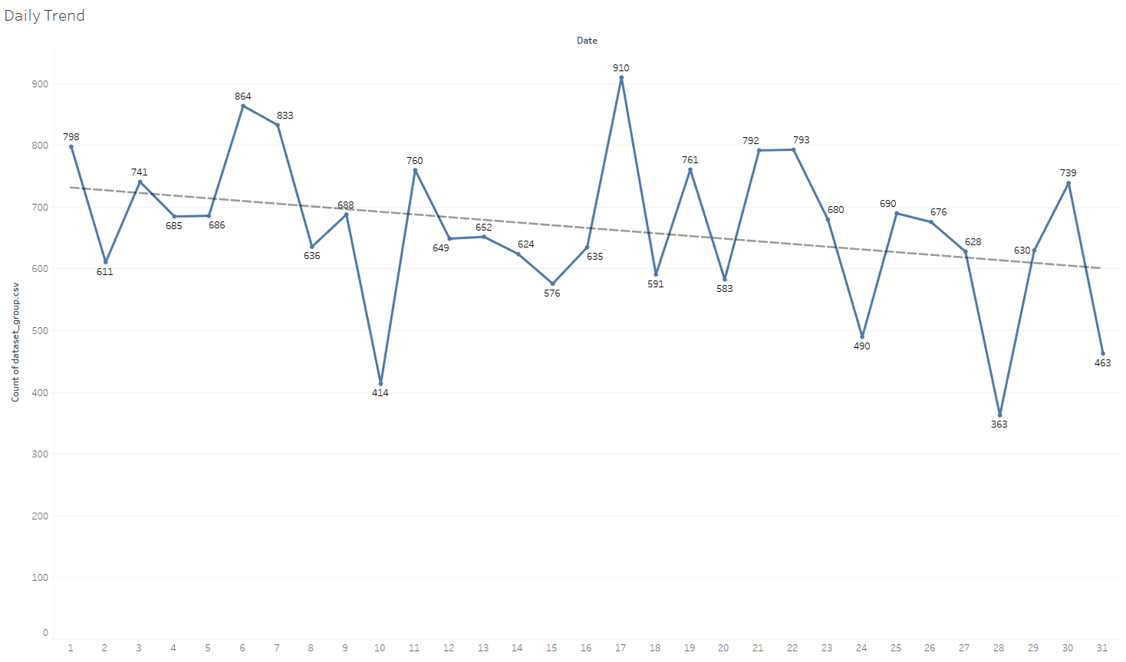
Data analysis – Uni Variate – Day Trend
Day trend has a declining sales, and the number of orders keep declining year on year.

Slide 6
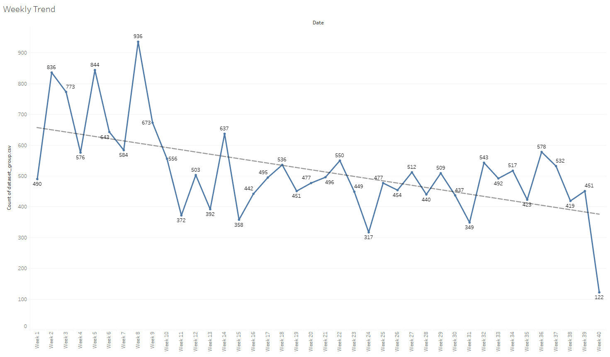
Data analysis – Uni Variate – Weekly Trend
Weekly trend has a stead decline of orders.
Week 8 has seen all the time high orders #936.
Week 40 has seen all the time low orders #122.

Slide 7
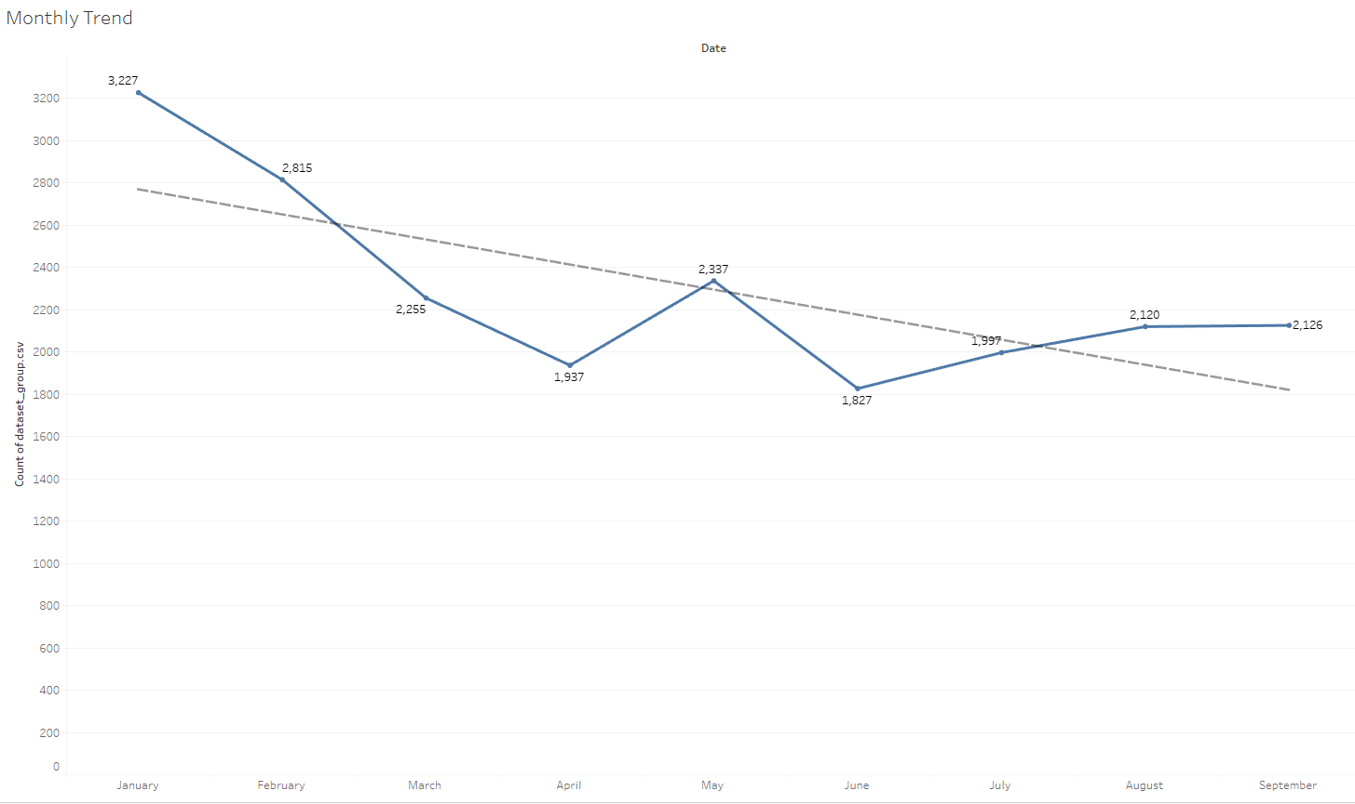
Data analysis – Uni Variate – Monthly Trend
Monthly trend has a decline, a rise and a steady trend.
January of the year has high orders as it could be due to new year sale.
May month has seen a rise in Orders.
Until September, Orders will be steady at #2000.

Slide 8
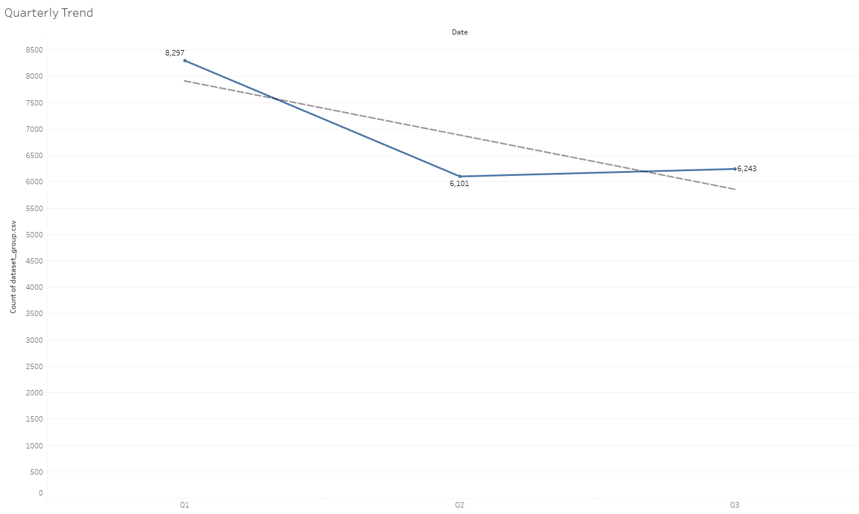
Data analysis – Uni Variate – Quarterly Trend
Quarterly trend has a decline, a steady rise trend.
Q1 has high Orders of all quarters.
Q2 has the lowest of Orders.
Q3 has a breakeven sales, lesser than Q1 Sales.

Slide 9
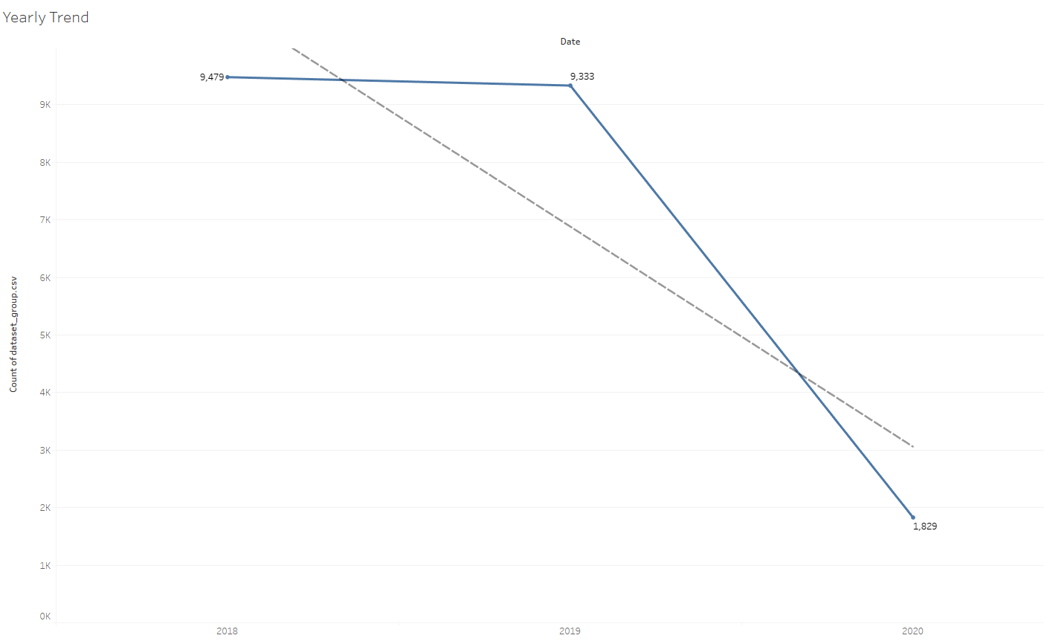
Data analysis – Uni Variate –Yearly Trend
Yearly trend has a heavy decline towards 2020.
2018 and 2019 have seen steady Orders of 9K.
Due to Covid, Orders have come down to #1829, there by not accruing profit for the organization comparatively to 2018/19.

Slide 10
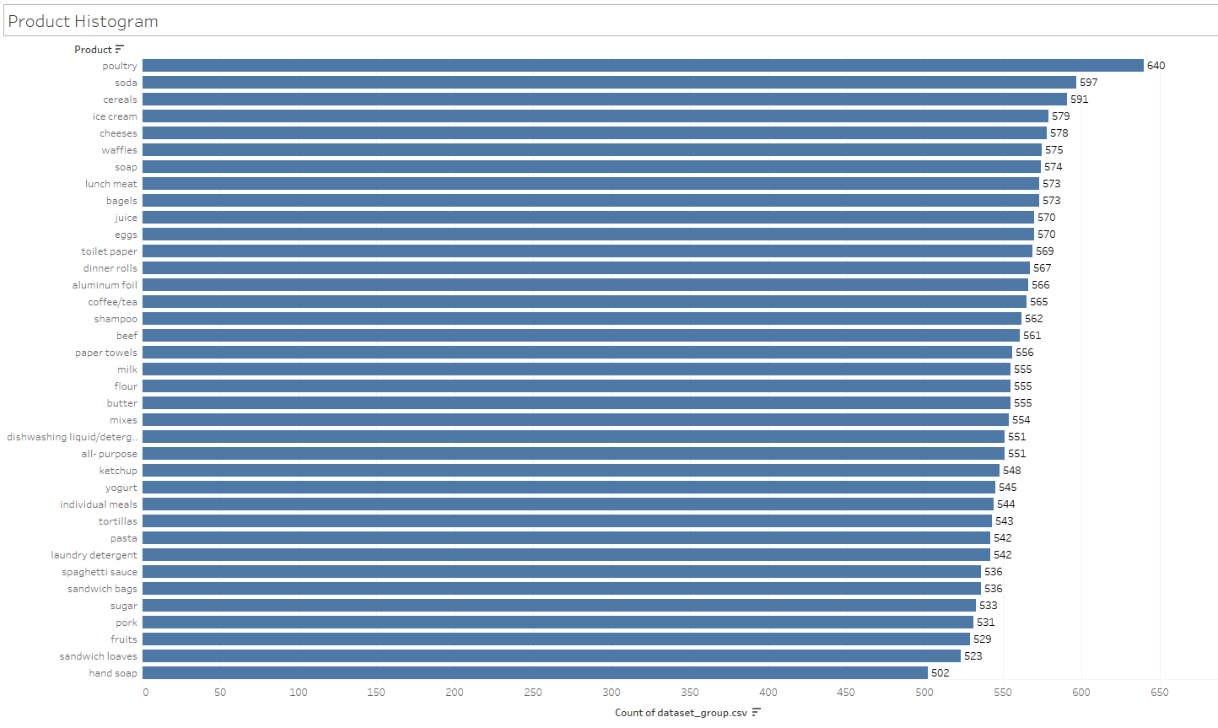
Data analysis – Uni Variate –Product
Poultry, Soda, Cereals, Ice cream products have seen maximum Orders.
Soaps have seen lowest of Orders.

Slide 11
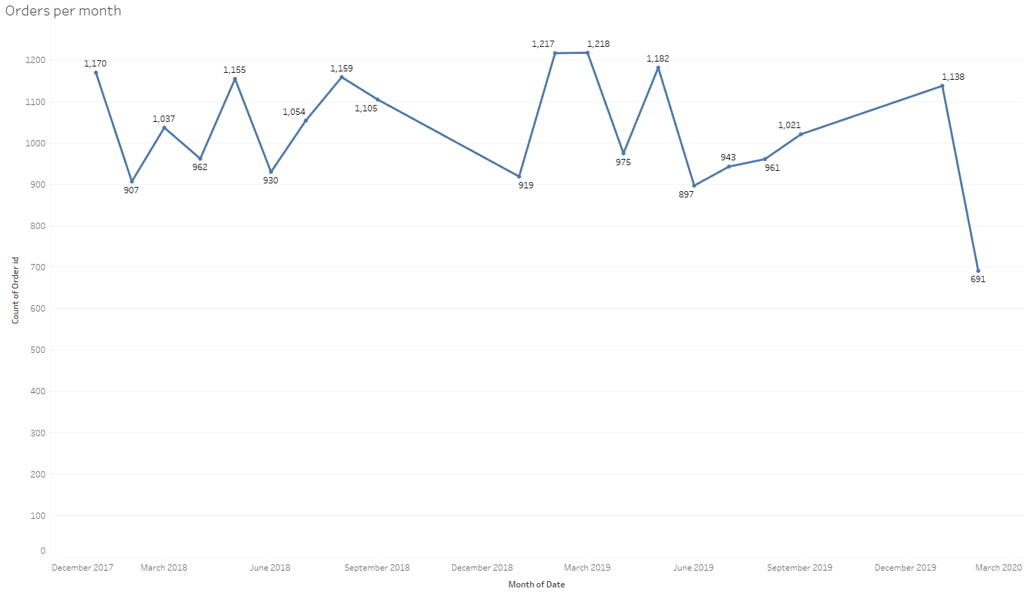
Data analysis – Bi Variate – Monthly Orders
March 2019 has seen highest of Orders.
March 2020 has seen lowest of Orders, probably due to Pandemic situation.

Slide 12
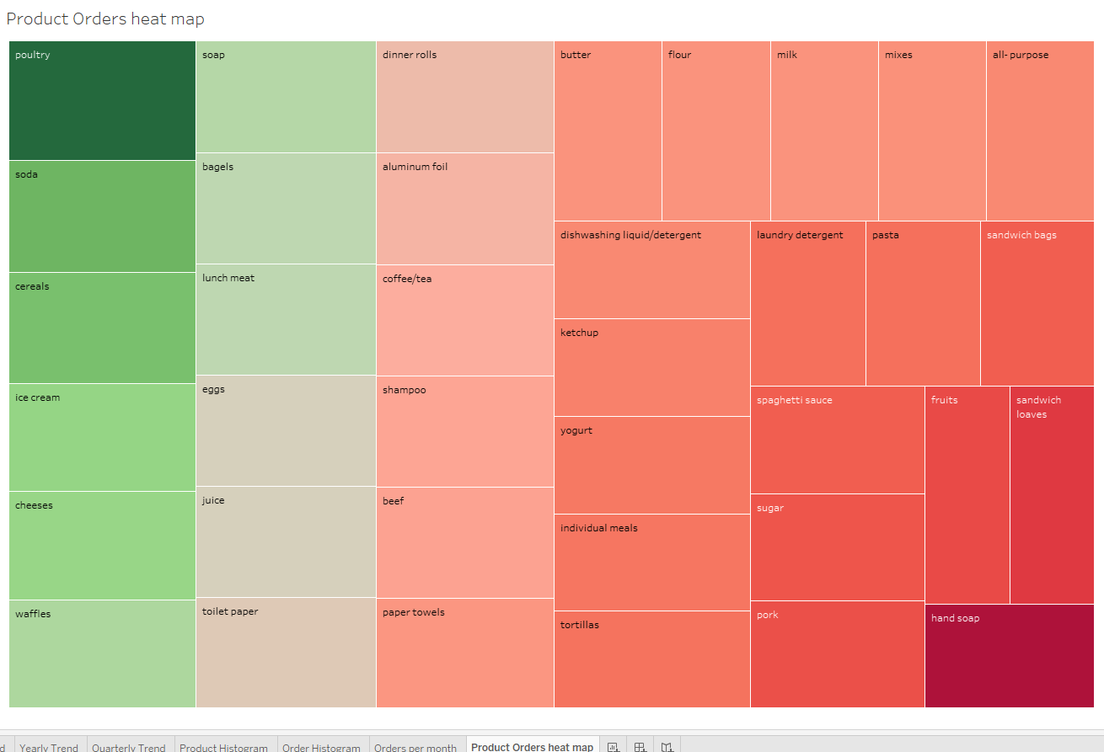
Data analysis – Bi Variate – Product Orders
Poultry has highest orders.
Hand Soap has lowest orders.

Slide 13
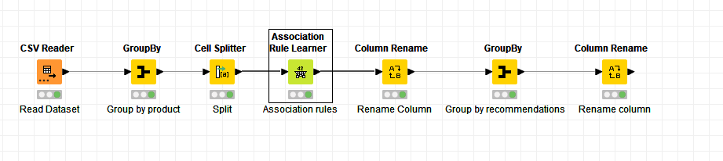
Market Basket Analysis
KNIME is used for deriving MBA.
Support, Confidence and Lift are used to generate Association Rules.
Threshold (Support (0.03) and Confidence (0.4)) is set. Support 0.03 will provide us with 151K rules to play with, more rules, more better basketing.
Confidence = 0.4 is set on a lower level, expecting at least 40% of records will have the recommendation to exist in the generated rule.
Lift was generated from Association rules derived from above and the best Lift obtained was 2.2 with a Confidence of 0.8 and Support of 0.31.
Iteratively, Confidence=0.4, Support 0.03 was proven to provide refinement and best lift among the association rules.

Slide 14
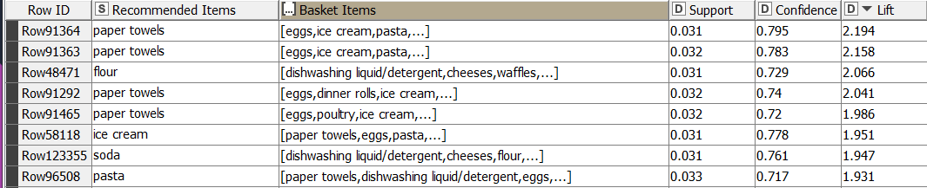
Market Basket Analysis – Association Rule Results
Basket Eggs, Ice Cream, pasta and Recommendation of “Paper Towels” obtained a higher lift of 2.194 and 2.158.
Explanation: Confidence; 80% of the time paper towels has been bought along with Paper Towels. Support; at 0.031, this combination is not a popular set. However, lift at 2.194 specifies if a customer buys [eggs, ice cream and pasta] there is 2X chances that he will buy paper towels.
Highest number of lift specifies, the correctness of Support and Confidence at 0.031 and 0.795.
Lowest lift is obtained for [cheese, waffles, sandwich bags] and Poultry, Organization will have zero profits from these and should not recommend.

Slide 15
Market Basket Analysis: Recommendations
Offers to provide:
Buy One and Get One free can be provided on [eggs, ice cream, pasta] basket as it is the product which provides more profits for the organization, due to it’s high Lift.
Paper Towels can be provided at half price who ever customer buys [eggs, ice cream and pasta].
Buy 2 Get 1 free can be provided on Paper Towels, as this Recommendation will be a combination for many Baskets, this will improve the Sale of cured Baskets.
[pork, sandwich, soap] and ketchup can be provided at buy 2 get 1 free offer as customers buying ketchup can buy other products like [tortillas, coffee, juice]
Offers to avoid:
Never provide Offers on Poultry along with Paper Towels, Waffles, Cheese, Yogurt, the combinations have very low lift and will not benefit the Organization.

